Slide 1

Tibbles and ggplot

Slide 2
Contents
Introduction to the tidyverse: tibbles
The diamonds dataset
Visualizing data in R with gpplot2

Slide 3
Tibbles

Slide 4
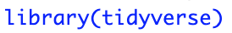
The tibble package
The tibble package is part of the core tidyverse
Tibbles are data frames with better printing (e.g., shows only top 10 rows)

Slide 5
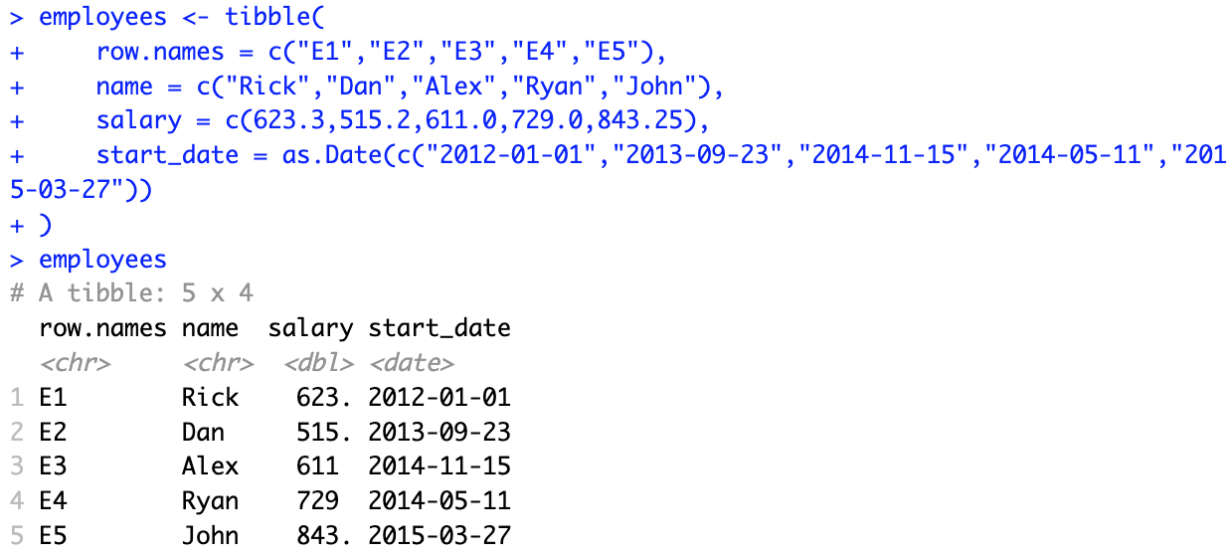
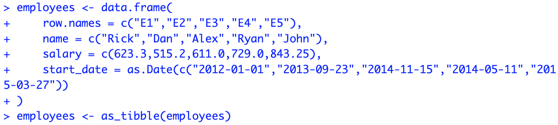
Creating tibbles
Conversion from data.frame to tibble:

Slide 6
Data example

Slide 7
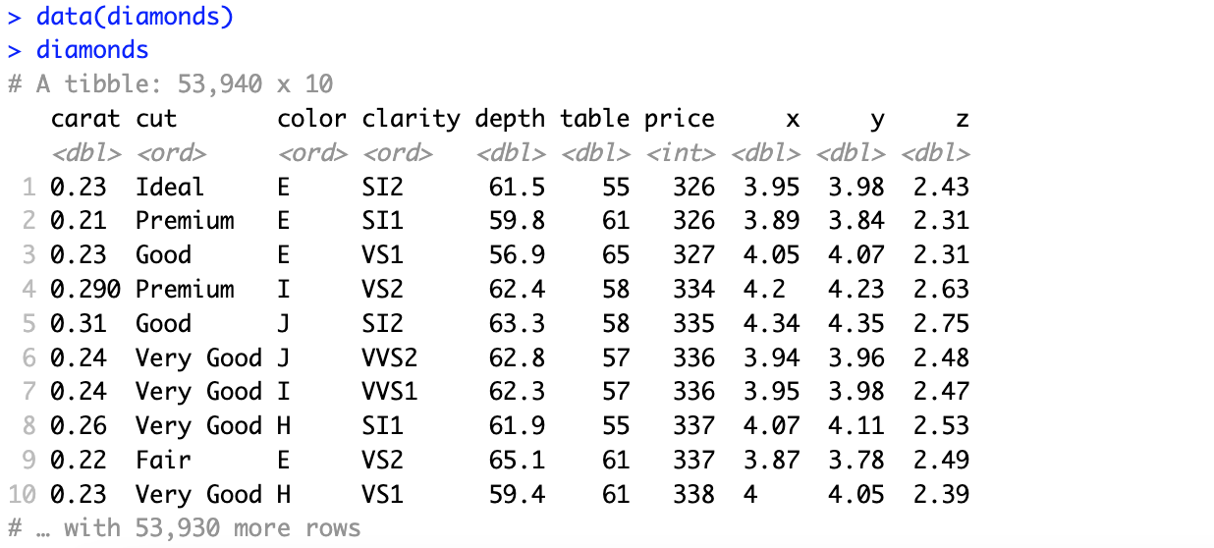
The diamonds dataset
Contains prices and other attributes of almost 54,000 diamonds
Included in tidyverse
More information with ?diamonds
Spreadsheet view in RStudio with View(diamonds)

Slide 8
Introduction to ggplot2

Slide 9
The ggplot2 package
The ggplot2 package is part of the core of tidyverse
It is the most elegant and versatile tool for graphically visualizing data in R, offering a coherent system (or grammar) for building graphs
Higher level of abstraction
Plots broken into layers
Beautiful graphics
Excellent documentation
Large user base

Slide 10
Building blocks of a ggplot2 graph
A ggplot2 graph is built up from a few basic elements:
The ggplot() function is used to initialize the basic graph structure
You need to add extra components to generate a graph
Specify different parts of a plot and add them using an + operator
Element | Symbol | Description
Data |  | The raw data that you want to plot
Geometries | geom_ | The geometric shapes that will represent the data
Aesthetics | aes() | Aesthetics of the geometric and statistical objects, such as color, size, shape, and position
Scales | scale_ | Maps between the data and the aesthetic dimensions, such as data range to plot width or factor values to colors

Slide 11
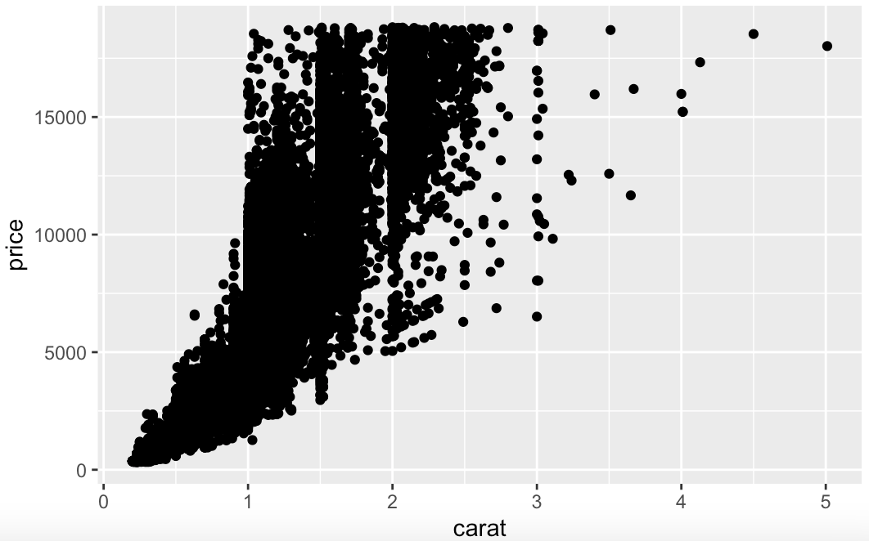
Creating a ggplot
Create a scatterplot with weight on the x-axis and price on the y-axis

Slide 12
Plots as objects
Whenever ggplot() is called, an object is created

Slide 13
Saving plots
Now that you have your beautiful plot, you may want to save it as an image
ggsave() is a convenient function for saving a plot
By default, it saves the last plot that you displayed, using the size of the current graphics device
It also guesses the type of graphics device from the extension
“Device” can be either a device function (e.g., png), or one or “eps”, “ps”, “text”, “pdf”, “jpeg”, “tiff”, “png”, “bmp”, “svg”, or “wmf” (Windows only)

Slide 14
Aesthetic mappings

Slide 15
What are aesthetic mappings?
Aesthetic means “something you can see”
Examples include:
Position (i.e., on the x and y axes)
Color (“outside” color)
Fill (“inside” color)
Shape (of points)
Linetype
Size
Each type of geom accepts only a subset of all aesthetics
You can convey information about your data by mapping the aesthetics in your plot to the variables in your dataset

Slide 16
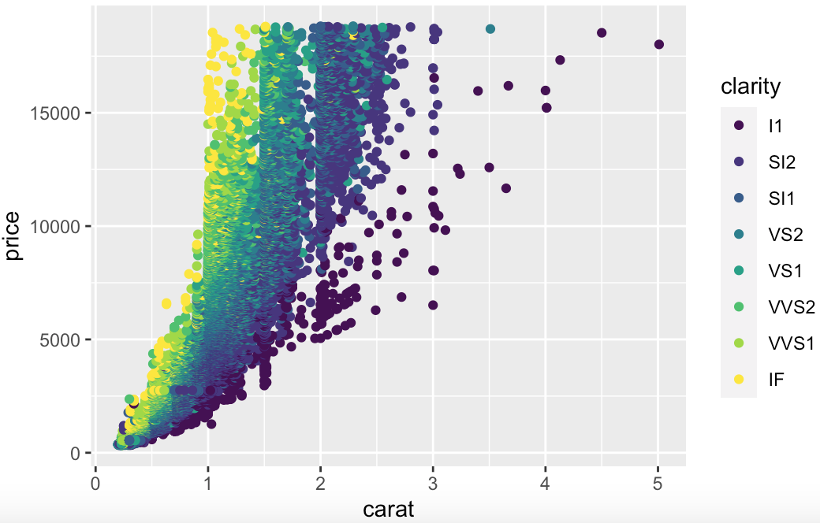
Adding a color aesthetic
We can color the points based on “clarity” by adding another aesthetic

Slide 17
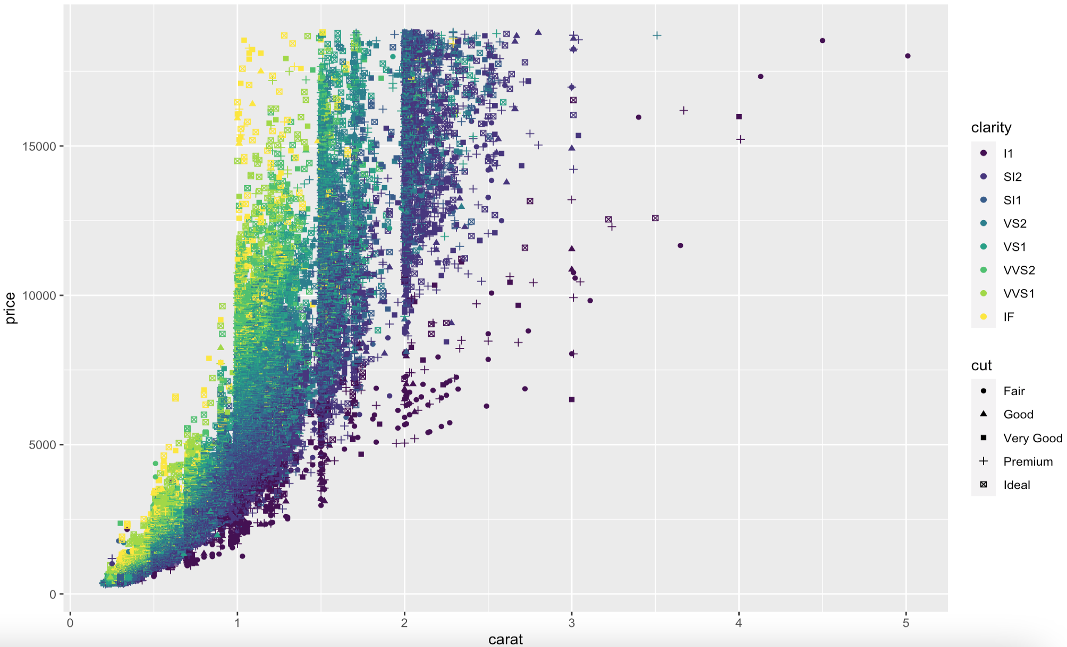
Adding a shape aesthetic

Slide 18
facets

Slide 19
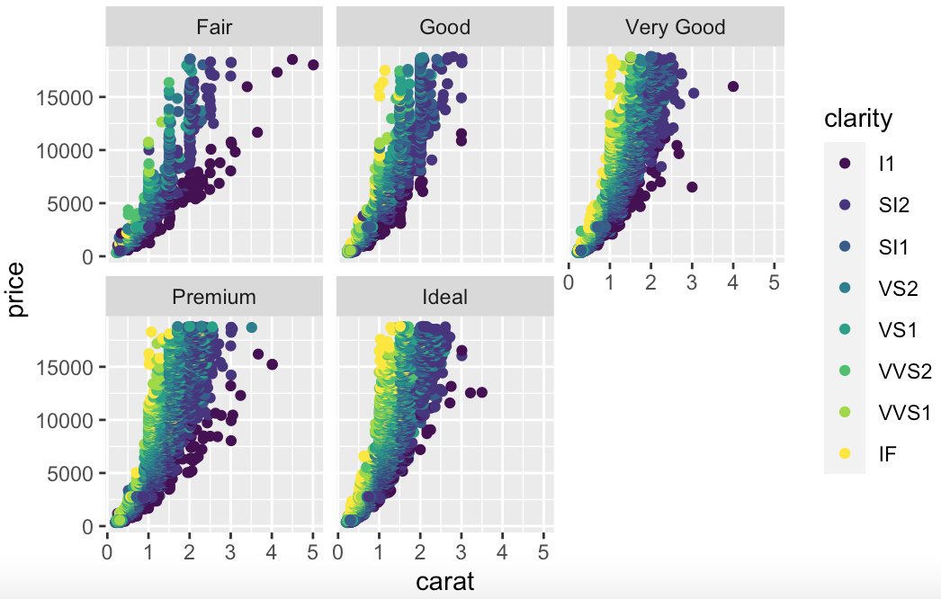
Facets for a categorical variable
Another way of adding categorical variables is to split your plot into facets

Slide 20
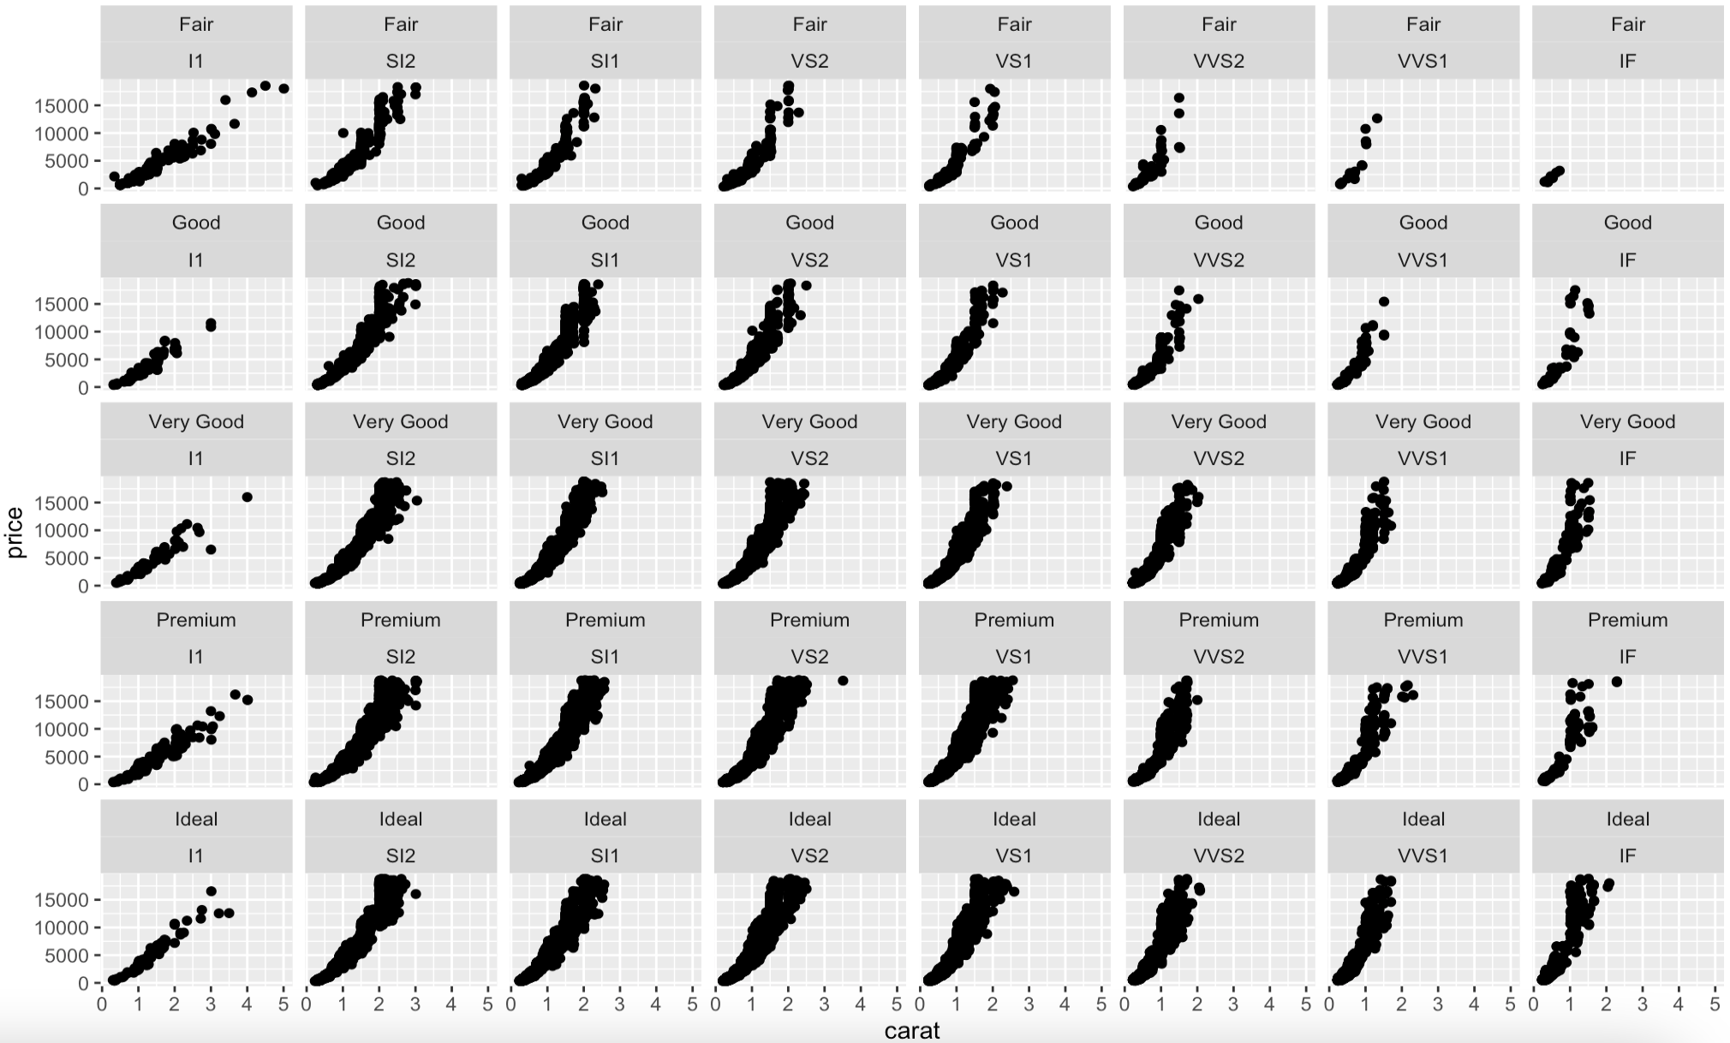
Facets for combinations of variables
You can facet your plot on the combination of two variables

Slide 21
Geometric objects

Slide 22
What are geometric objects?
Geometric objects are the marks we put on the plot
Examples:
Points (geom_point for scatter plots, dot plots, …)
Lines (geom_line for time series; geom_smooth for trend lines, …)
Boxplot (geom_boxplot for boxplots)
A plot must have at least one geom, but there is no upper limit
You can add a geom to a plot using the + operator
For a list of available geometric objects:

Slide 23
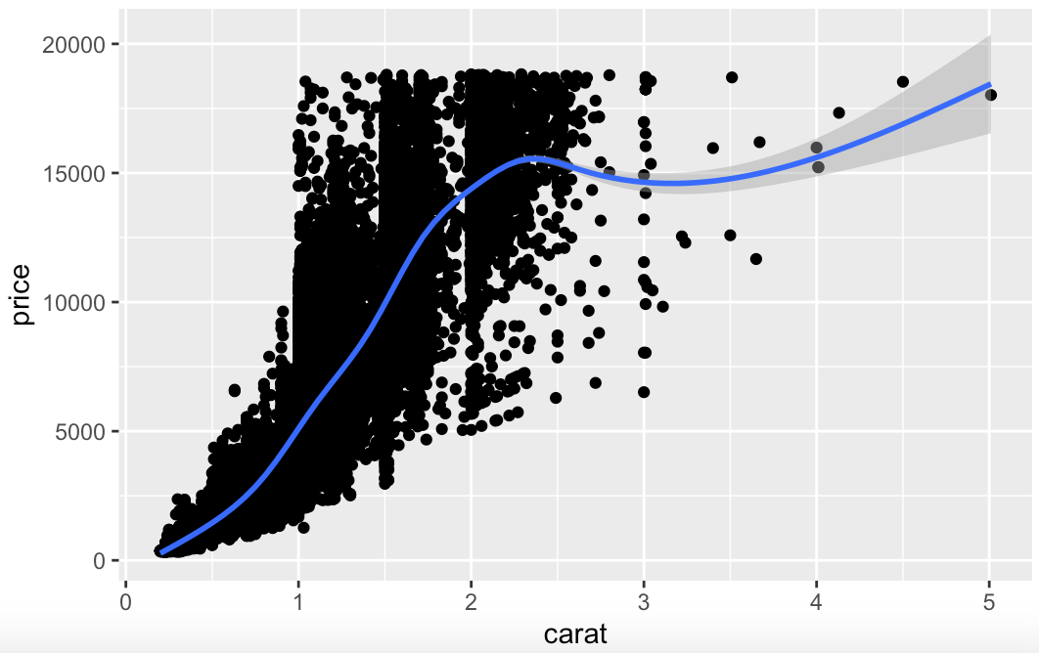
Adding a smoothing trend
The shaded area represents uncertainty in this smoothing curve

Slide 24
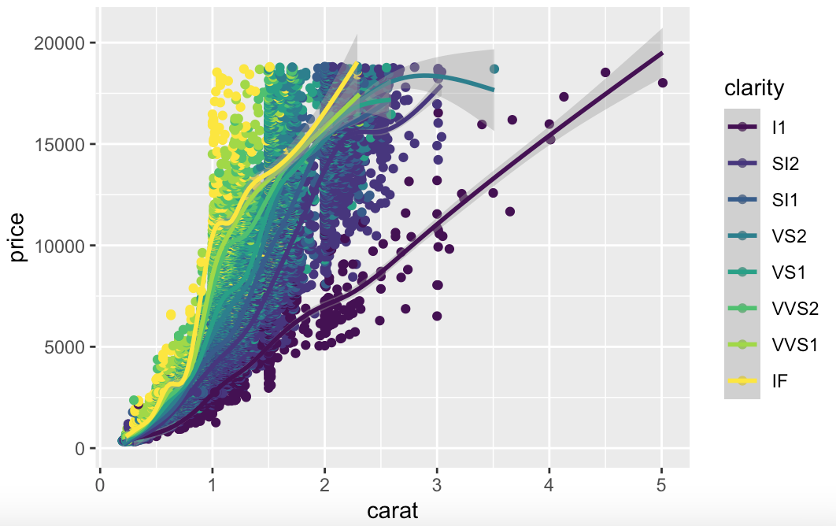
Adding a smoothing trend
With a color aesthetic, ggplot will create one smoothing curve for each color

Slide 25
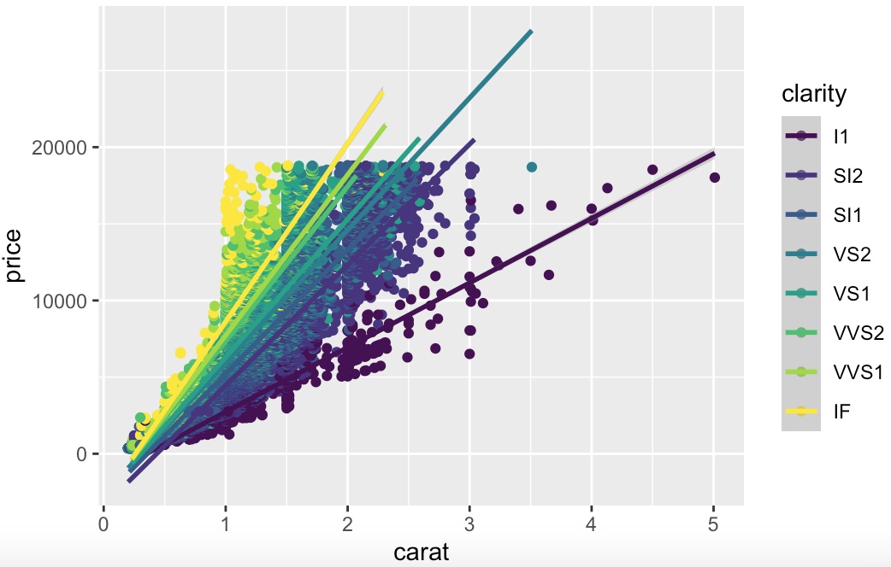
Changing the smoothing method
Type help(geom_smooth, ggplot2) for more options

Slide 26
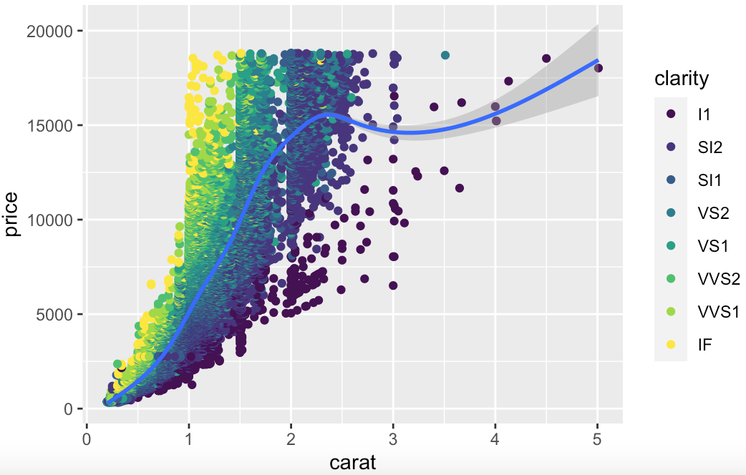
Specifying geometric object aesthetics
Aesthetics can also be specified for a single geometric object

Slide 27
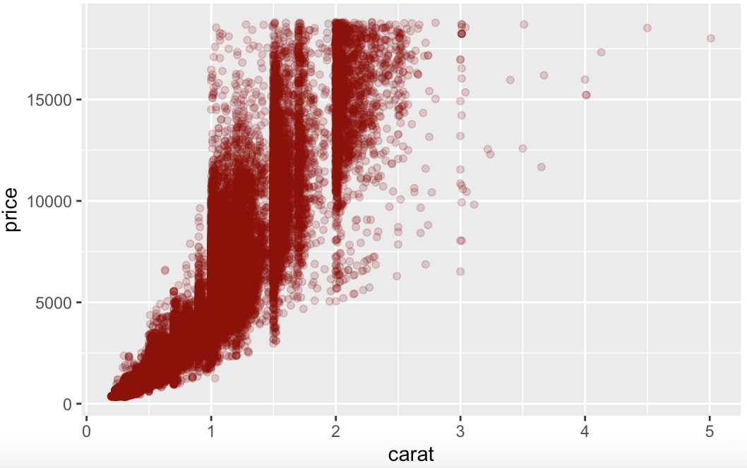
Aesthetic mappings vs. fixed aesthetics
Set the same color and transparency for all observations

Slide 28
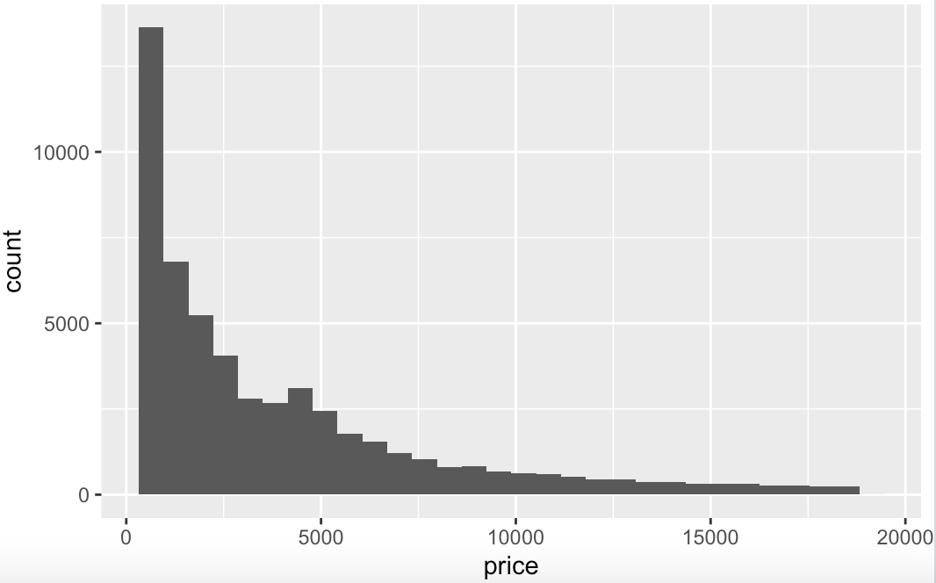
histograms

Slide 29
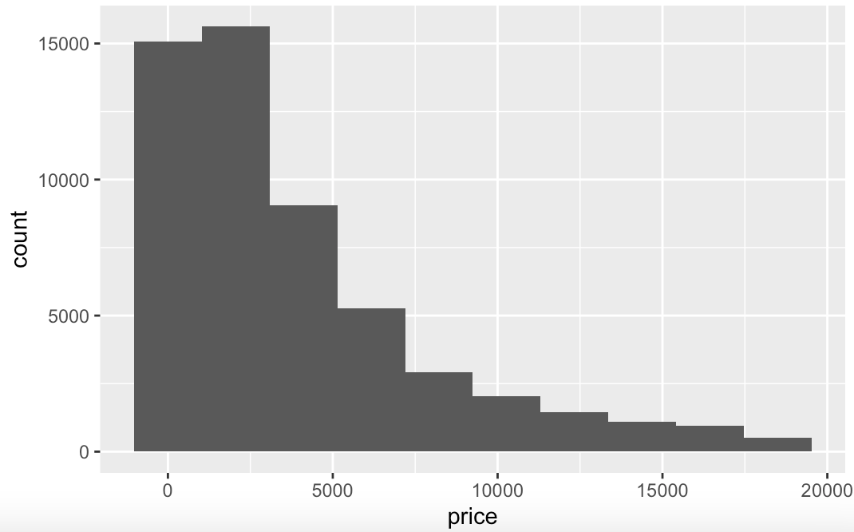
Customizing histograms
You can specify the number of bins or the bin width

Slide 30
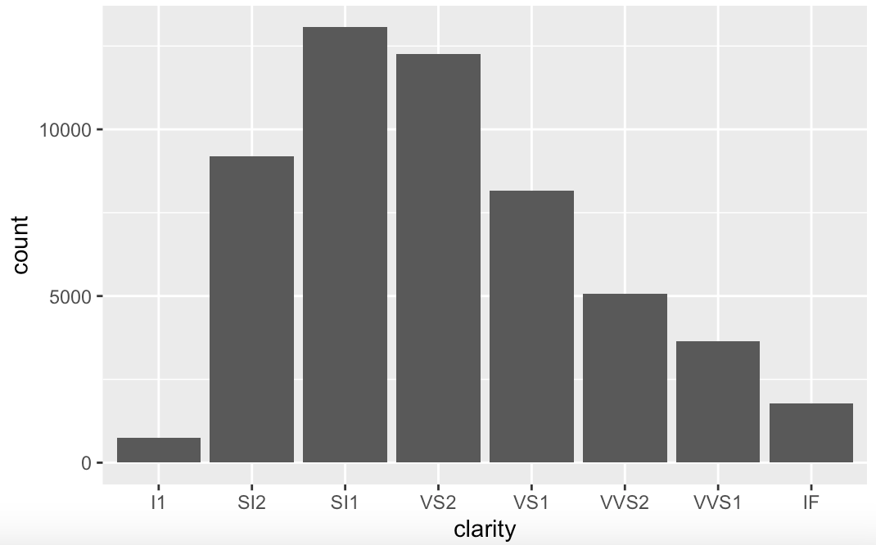
Bar charts
A discrete analogue of a histogram is the bar chart
The geom_bar counts the number of instances of each discrete class

Slide 31
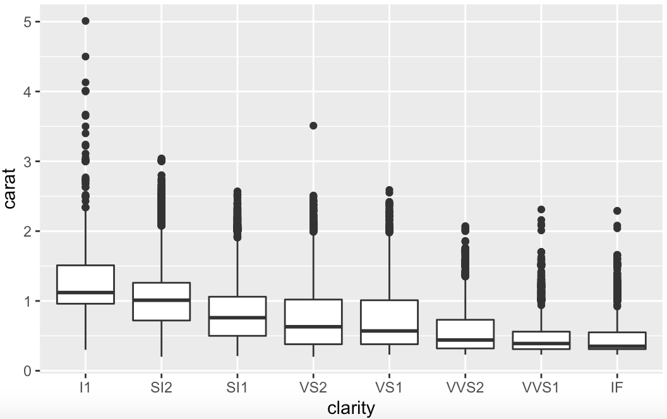
boxplots
Boxplots graphically depict groups of numerical data through their quartiles

Slide 32
scales

Slide 33
Aesthetic mapping vs. variable scaling
aes() assigns an aesthetic to a variable, but it doesn’t determine how mapping should be done
For example, aes(shape = x) or aes(color = z) do not specify what shapes or what colors should be used
To choose colors/shapes/sizes, etc., you need to modify the corresponding scale
ggplot2 includes scales for:
Position
Color and fill
Size
Shape
Line type
Scales can be modified with functions of the form:
In RStudio, type scale_ followed by TAB to list all available scales

Slide 34

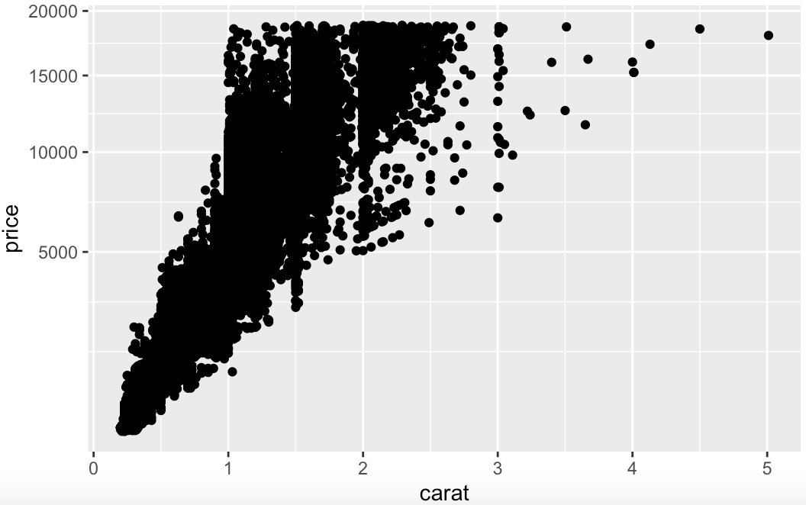
Scales for axes
Square-root transformation on the y-axis:

Slide 35
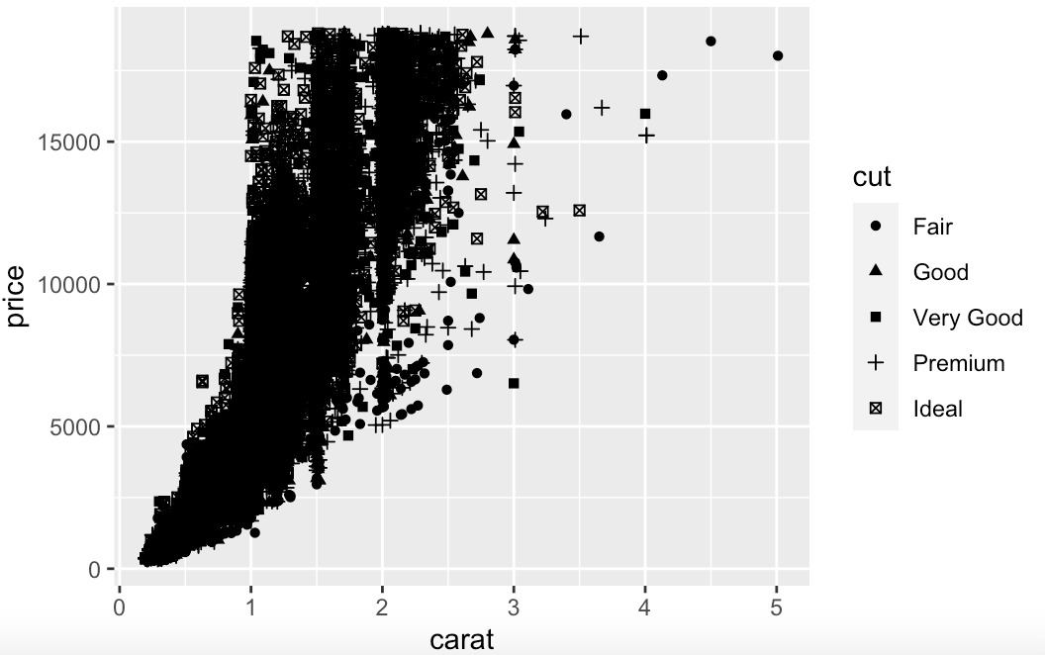

Scales for shapes

Slide 36
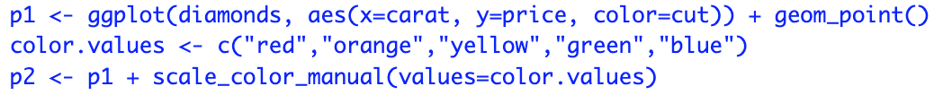
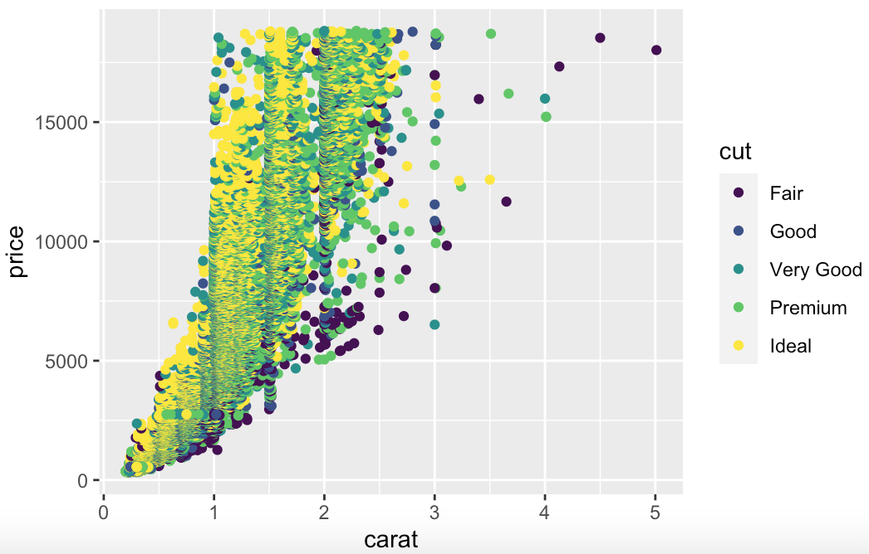
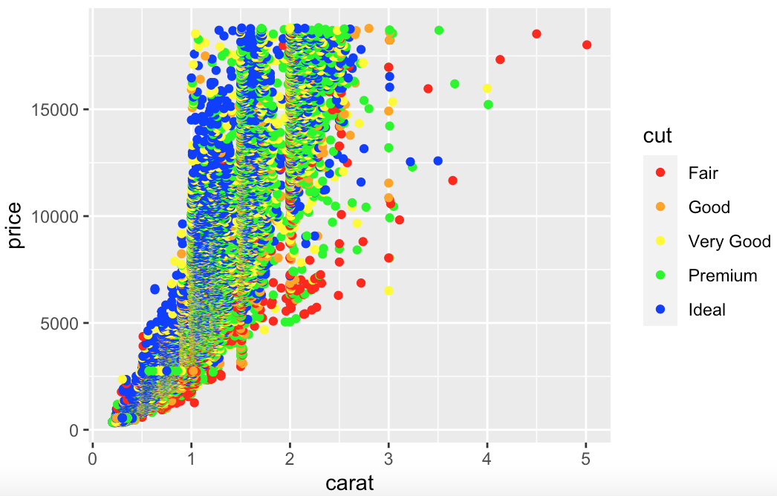
Scales for discrete colors
To choose specific colors for discrete variables, we use scale_color_manual()
You can also use default palettes with scale_color_brewer

Slide 37

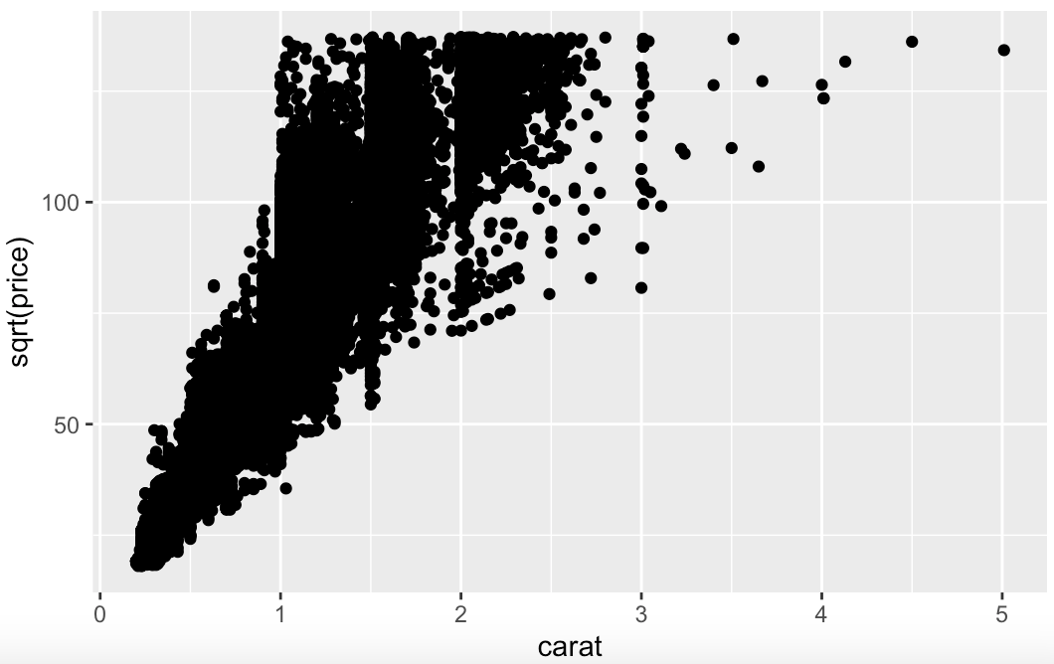
Manual transformations
You can also define your own transformations, e.g., position scaling
Square root transformation on the y-axis
Note that the labels on the y-axis are different

Slide 38

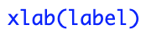
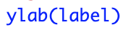
Modify axis, legend, and plot labels
Good labels are critical for making your plots accessible to a wider audience
Some of the most useful ggplot2 functions:
You can even display mathematical formulae using the function expression()

Slide 39

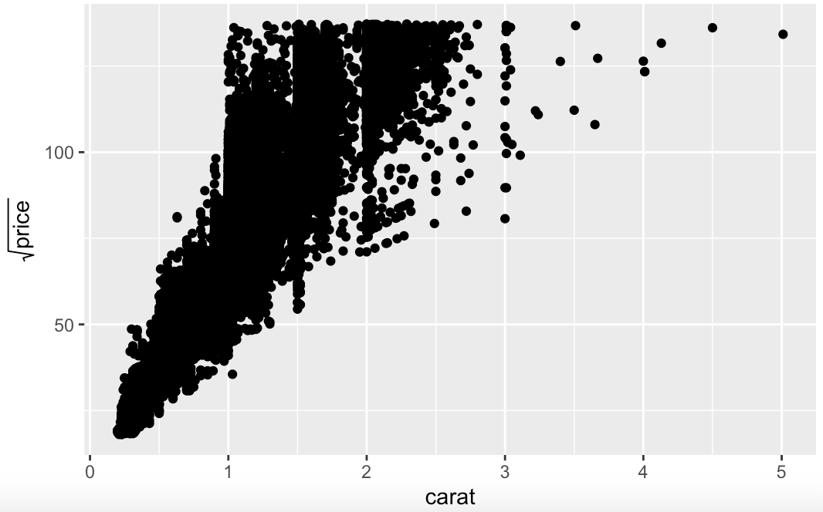
Axis labels with mathematical expressions
Square root transformation on the y-axis

Slide 40
Statistical transformations

Slide 41
What are statistical transformations?
Many graphs, like scatterplots, plot the raw values of your dataset
Other graphs, like bar charts, calculate new values to plot:
Bar charts and histograms bin your data and then plot bin counts
Smoothers fit a model to your data and then plot predictions
Boxplots compute a robust summary of the distribution and then display it
The algorithm used to calculate new values for a graph is called a stat

Slide 42
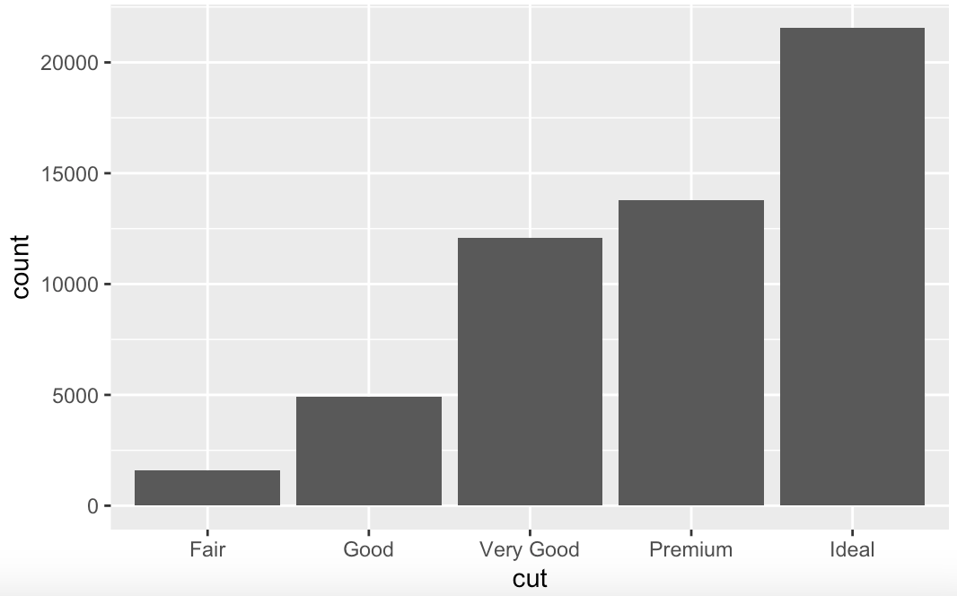
Geom vs. stat
You can generally use geoms and stats interchangeably
Every geom has a default stat, and every stat has a default geom

Slide 43
Why should you know about stat?
You may want to:
Override the default stat, e.g., in a bar chart with frequencies already in the dataset, use stat_identity instead of the default stat_count
Override the default mapping from transformed variables to aesthetics, e.g., bar chart of proportion, rather than count
Draw greater attention to the statistical transformation in your code, e.g., stat_summary summarizes the y values for each unique x value
ggplot2 provides over 20 stats for you to use

Slide 44
The layered grammar of graphics

Slide 45
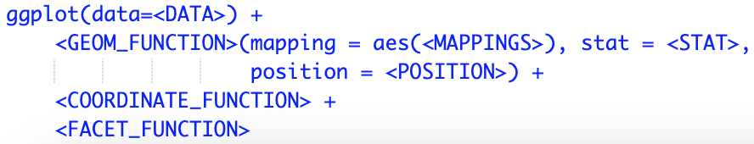
A code template
We now have a foundation to make any type of plot:
This composes the grammar of graphics, a formal system for building plots
In practice, we don’t need all: ggplot2 will provide useful defaults for everything except:
The data
The mappings
The geom function
Coordinate systems are a little more complicated
The default is Cartesian: x and y positions act independently to determine the location of each point

Slide 46
Summary of the workflow
At this point, we have developed a general recipe for making any plot
Specify the dataset
Transform it into the information that you want to display (stat_)
Choose a geometric object to represent each observation in the transformed data (geom_)
Select a coordinate system to place the geoms into (default: Cartesian)
If needed, extend the plot by adding layers
If needed, create multiple plots with facets

